Slide 1
Software Testing
Lecture 1
By
Naseem us Sehar

Slide 2
Introduction
What is software engineering?
Why testing a product is necessary?
Why study software testing?
Goals of the course Software Testing
Opportunities for software testers

Slide 3
Outline
The Quality Revolution
Software Quality
Role of Testing
Verification and Validation
Failure, Error, Fault and Defect

Slide 4
Quality Revolution
Started in Japan by Deming, Juran, and Ishikawa during 1940s
In 1950s, Deming introduced statistical quality control to Japanese engineers
Statistical quality control (SQC) is a discipline based on measurement and statistics
SQC methods use seven basic quality management tool
Pareto analysis, Trend Chart, Flow chart, Histogram, Scatter diagram, Control chart, Cause and effect diagram
“Lean principle” was developed by Taiichi Ohno of Toyota
“A systematic approach to identifying and eliminating waste through continuous improvement, flowing the product at the pull of the customer in pursuit of perfection.”

Slide 5
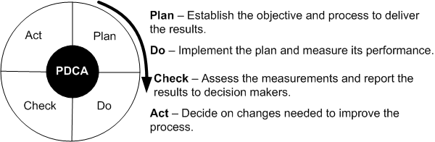
Quality Revolution

Slide 6
Quality revolution
Deming introduced Shewhart’s PDCA cycle to Japanese researchers
It illustrate the activity sequence:
Setting goals
Assigning them to measurable milestones
Assessing the progress against the milestones
Take action to improve the process in the next cycle

Slide 7
Quality Revolution
In 1954, Juran spurred the move from SQC to TQC (Total Quality Control)
Key Elements of TQC:
Quality comes first, not short-term profits
The customer comes first, not the producer
Decisions are based on facts and data
Management is participatory and respectful of all employees
Management is driven by cross-functional committees

Slide 8
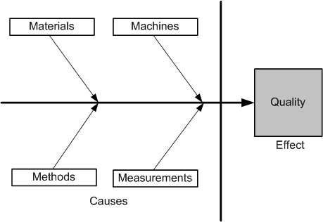
Cause-and-effect diagram

Slide 9
Software quality
Software Quality in terms of quality factors and criteria
A quality factor represents behavioral characteristic of a system
Examples: correctness, reliability, efficiency, and testability
A quality criterion is an attribute of a quality factor that is related to software development
Five Views of Software Quality:
Transcendental view
User’s view
Manufacturing view
Product view
Value-based view

Slide 10
Role of testing
Software quality assessment divide into two categories:
Static analysis
It examines the code and reasons over all behaviors that might arise during run time
Examples: Code review, inspection, and algorithm analysis
Dynamic analysis
Actual program execution to expose possible program failure
One observe some representative program behavior, and reach conclusion about the quality of the system

